Slide 1

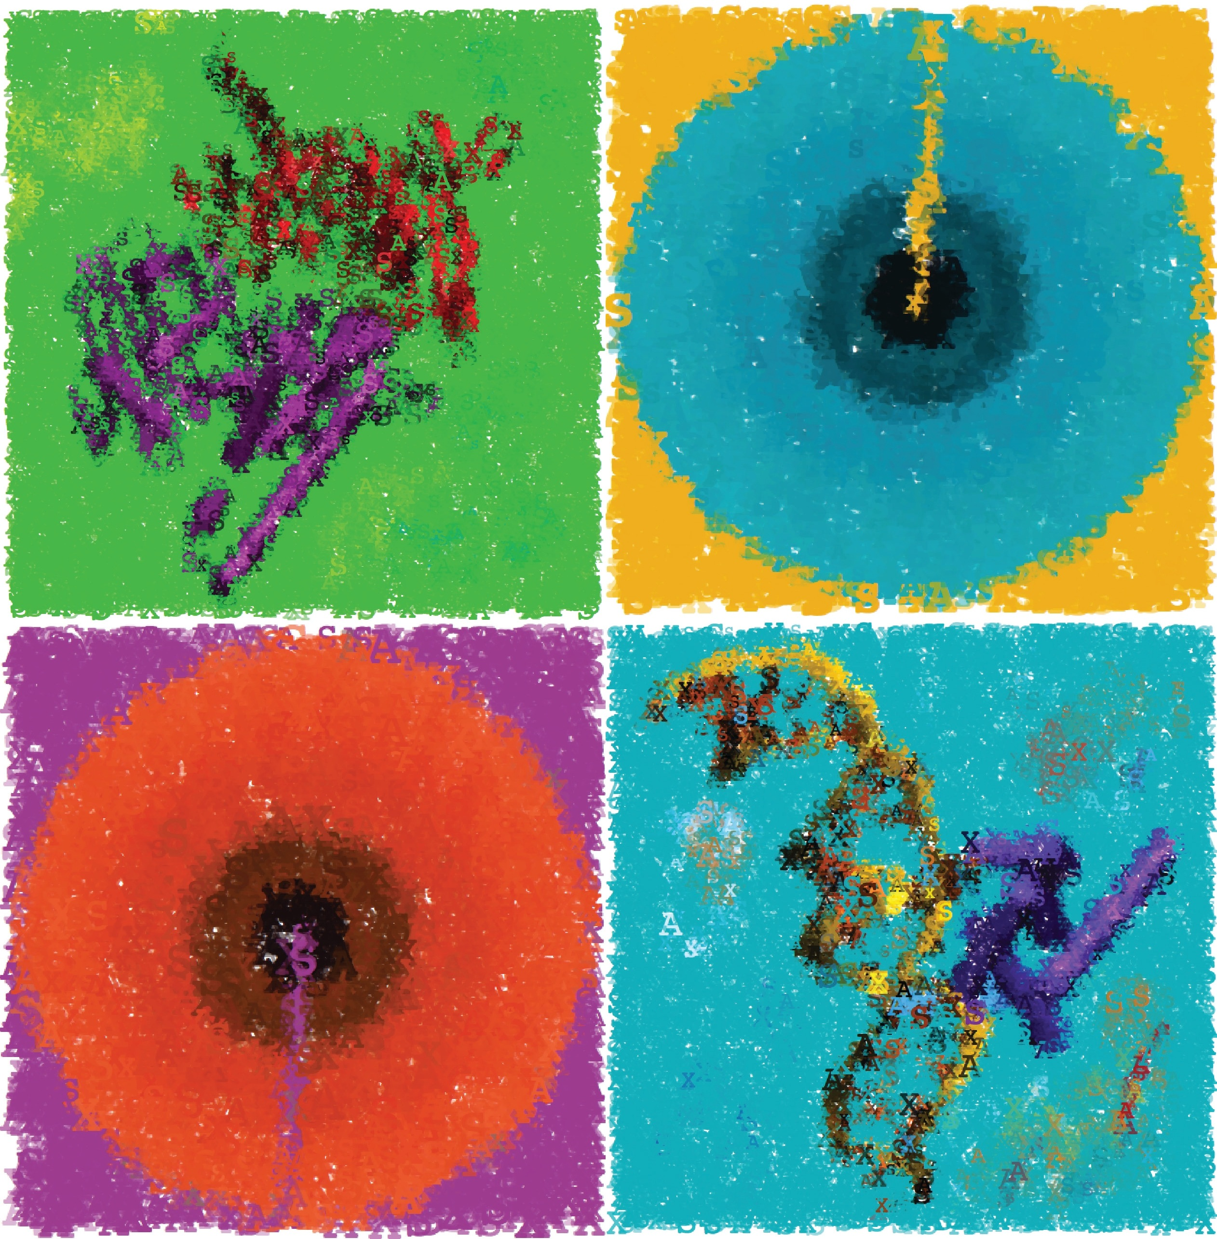
3D Data Processing in Structural Biology Optimization methods for ab initio protein folding part II
April 11th, 2021

Slide 2
Outline
Introduction to ab initio modeling (folding)
Common optimization methods
Local Minimization Methods (derivative-based)
Markov-chain Monte-Carlo Sampling (MCMC)
MCMC approaches to protein folding

Slide 3
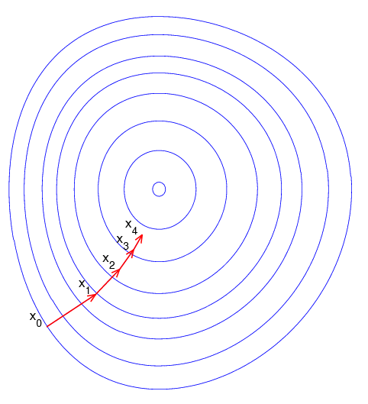
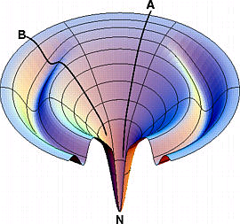
Gradient Descent Minimization Algorithm
Sliding down an energy gradient
good ( = global minimum)
local minimum
Image by Ken Dill

Slide 4
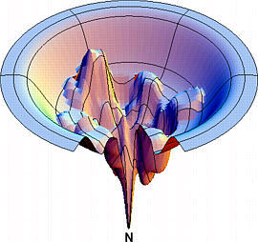
Gradient Descent – System Description
Coordinates vector (Cartesian or Internal coordinates): x=(x₁, x₂,…,x_{n})
Differentiable energy function: E(X)
Gradient vector:
*Adapted from slides by Chen Kaeasar, Ben-Gurion University

Slide 5
Gradient Descent Minimization Algorithm:
Parameters: λ = step size ; ε = convergence threshold
x = random starting point
While ⎥(x)⎢>ε
x_{new} = x - λ(x)
Line search: find the best step size λ minimizing E(x_{new}) (discussion later)
Note on convergence condition: in local minima, the gradient must be zero (but not always the other way around)

Slide 6
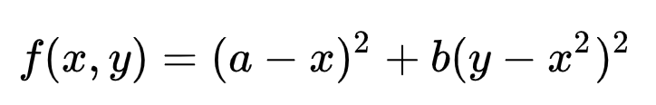
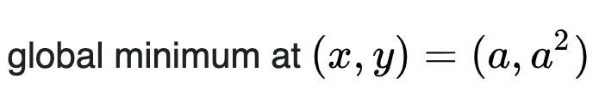
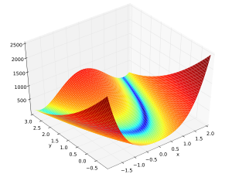
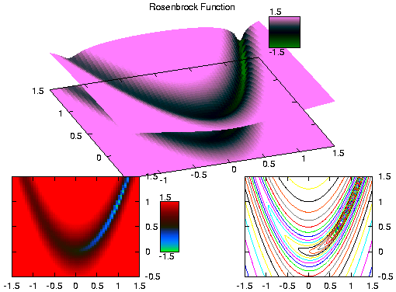
2-D Rosenbrock’s Function: a Banana Shaped Valley Pathologically Slow Convergence for Gradient Descent
0 iterations
a=1, b=100
1000 iterations
100 iterations
10 iterations
The (very common) problem: a narrow, winding “valley” in the energy landscape leads to miniscule, zigzag steps

Slide 7
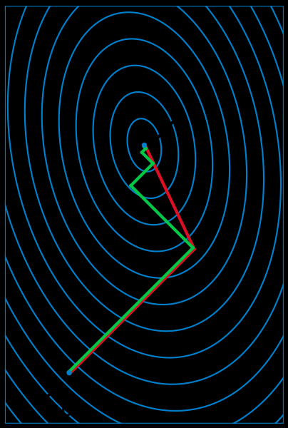
(One) solution: non-linear conjugate gradient descent (derived from linear version, Hestenes and Eduards, 1952)
Use a (smart) linear combination of gradients from previous iterations to prevent zigzag motion
Parameters: λ = step size ; ε = convergence threshold
x₀ = random starting point
Λ₀ = (x₀)
While⎥ Λ_{i} ⎢ > ε
Λ_{i+1} = (x_{i}) + β_{i}∙Λ_{i}
choice of β_{i} is important (Fletcher-Reeves, Polak-Ribiere, Hestenes-Stiefel, Dai-Yuan, etc.)
X_{i+1} = x_{i} + λ ∙ Λ_{i}
Line search: adjust step size λ to minimize E(X_{i+1})
Conjugated gradient descent
gradient descent
Works best when the surface is approximately quadratic near the minimum (convergence in N iterations), otherwise need to reset the search every N steps (N = dimension of space)

Slide 8
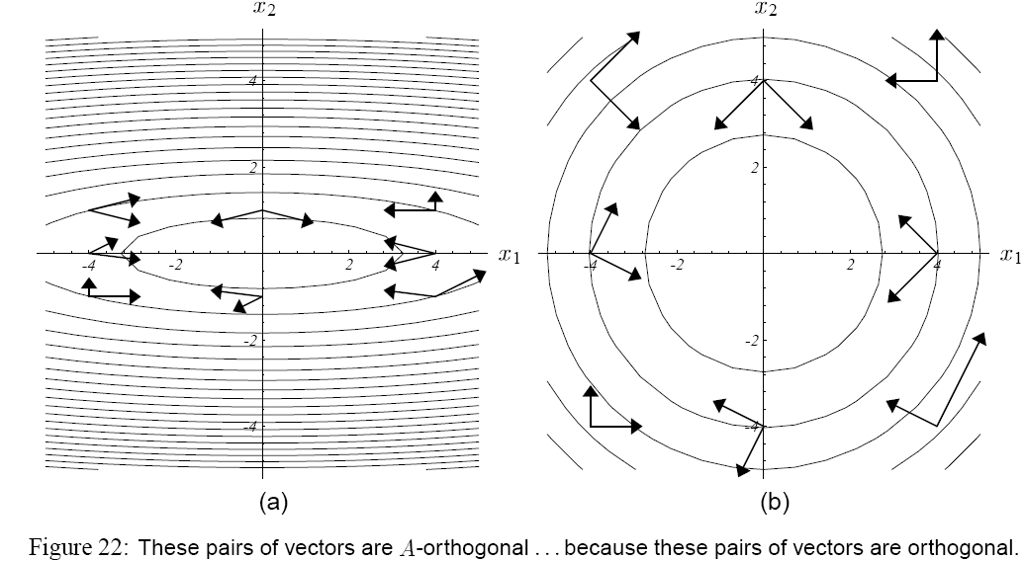
A-orthogonality in conjugate GD
A is a transformation that “stretches” the narrow vallies, thus enabling search only in orthogonal directions (post-stretching)
Image taken from: An Introduction to the Conjugate Gradient Method without the Agonizing Pain. Shewchuk 1994

Slide 9
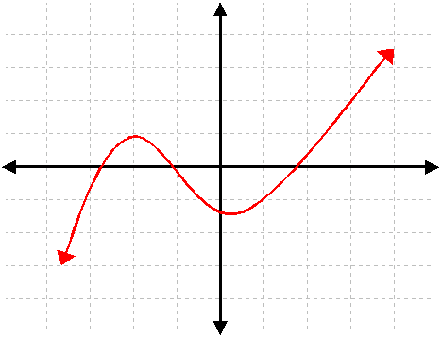
Finding a local minimum through root finding – when does f(x) = 0?

Slide 10
Root finding using Taylor’s Series
First order approximation:
Second order approximation:
The full Series:

Slide 11
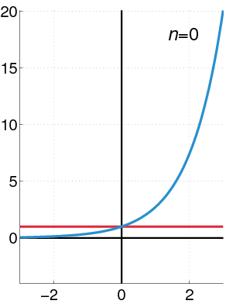
Taylor’s Approximation: f(x)=e^{x}

Slide 12
Taylor’s Approximation of f(x) = sin(x)^{2x} at x=1.5

Slide 13
Taylor’s Approximation of f(x) = sin(x)^{2x} at x=1.5

Slide 14
Taylor’s Approximation of f(x) = sin(x)^{2x} at x=1.5

Slide 15
Taylor’s Approximation of f(x) = sin(x)^{2x} at x=1.5

Slide 16
From Taylor’s Series to Root Finding (one-dimension)
First order approximation:
Root finding by Taylor’s approximation:

Slide 17
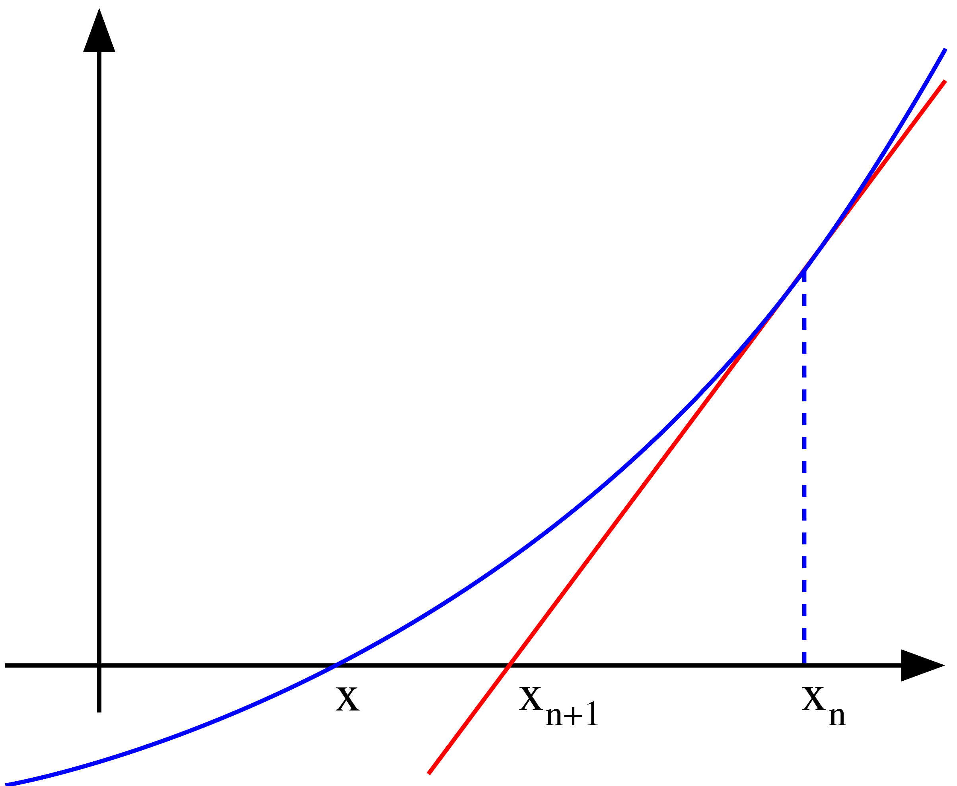
Newton-Raphson Method for Root Finding (one-dimension)
Start from a random x₀
While not converged, update x with Taylor’s series:

Slide 18
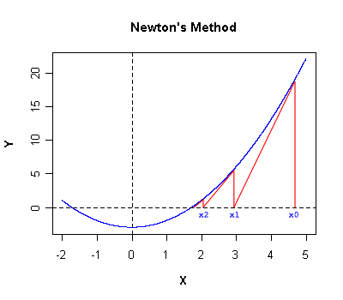
Newton-Raphson: Quadratic Convergence Rate
THEOREM: Let x_{root} be a “nice” root of f(x). There exists a “neighborhood” of some size Δ around x_{root} , in which Newton method will converge towards x_{root} quadratically ( = the error decreases quadratically in each round)
Image from http://www.codecogs.com/d-ox/maths/rootfinding/newton.php

Slide 19
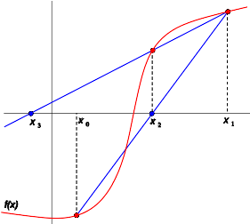
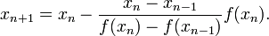
The Secant Method (one-dimension)
Just like Newton-Raphson, but approximate the derivative by drawing a secant line between two previous points:
Secant algorithm:
Start from two random points: x₀, x₁
While not converged:
Theoretical convergence rate: golden-ratio (~1.62)
Often faster in practice: no gradient calculations

Slide 20
Newton’s Method: from Root Finding to Minimization
First order approximation:
take derivative (by X)
Minimum is reached when derivative of appriximation is zero:
So… this is just root finding over the derivative (which makes sense since in local minima, the gradient is zero).

Slide 21
Newton’s Method for Minimization:
Start from a random vector x=x₀
While not converged, update x with Taylor’s series:
Notes:
if f’’(x)>0, then x is surely a local minimum point
We can choose a different step size than one

Slide 22
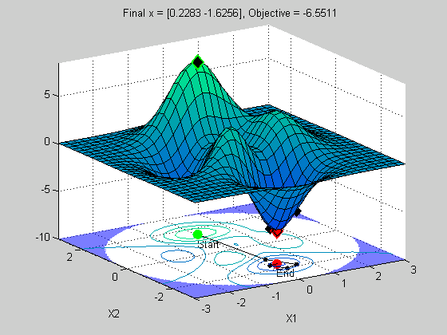
Newton’s Method for Minimization: Higher Dimensions
Start from a random vector x=x₀
While not converged, update x using Taylor’s series:
Notes:
H is the Hessian matrix (generalization of second derivative to high dimensions)
We can choose a different step size using Line Search (see previous slides)

Slide 23
Quasi-Newton Methods: generalizing the Secant method for higher dimensions
Calculating the Hessian (2nd derivative) is expensive ➔ numerical calculation of Hessian
Popular methods:
DFP (Davidson – Fletcher – Powell)
BFGS (Broyden – Fletcher – Goldfarb – Shanno)
Combinations
Timeline:
Secant method (ancient Babylon-16th century) ➔ Newton-Raphson (17th century) ➔ DFP (1959, 1963) ➔ Broyden Method for roots (1965) ➔ BFGS (1970)

Slide 24
Comparison of Derivative Methods
Quasi-Newton methods take less iterations to converge than conjugate gradient descent, but:
The computation in each iteration is more complex
Takes more memory (a limited memory variant called L-BFGS)
For Qusai-Newton methods, BFGS is generally considered superior to the older DFP.
They can be also combined together
Rosetta currently uses DFP, with Brent or Armijo Line-Search

Slide 25
Additional resources on gradient-based methods
General overview https://ruder.io/optimizing-gradient-descent/index.html
Conjugate Gradient Descent http://www.cs.cmu.edu/~quake-papers/painless-conjugate-gradient.pdf
Quasi-Newton Methods http://www.srl.gatech.edu/education/ME6103/Quasi-Newton.ppt
HUJI course on non-linear optimization by Benjamin Yakir http://pluto.huji.ac.il/~msby/opt-files/optimization.html
Line search
http://pluto.huji.ac.il/~msby/opt-files/opt04.pdf
http://www.physiol.ox.ac.uk/Computing/Online_Documentation/Matlab/toolbox/nnet/backpr59.html
Golden section & parabolic bracketing - http://www.bip.bham.ac.uk/osmart/msc/lect/lect2a.html
Stochastic gradient descent (popular for training deep NNs) https://arxiv.org/abs/1412.6980 https://machinelearningmastery.com/adam-optimization-algorithm-for-deep-learning/
Adam (adaptive moment estimation) https://arxiv.org/abs/1412.6980 https://machinelearningmastery.com/adam-optimization-algorithm-for-deep-learning/

Slide 26
Outline
Introduction to ab initio modeling (folding)
Common optimization methods
Local Minimization Methods (derivative-based)
Markov-chain Monte-Carlo Sampling (MCMC)
MCMC approaches to protein folding

Slide 27
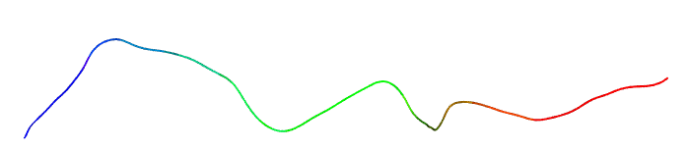
Harder Goal: Move from an Arbitrary Model to a Correct One
Example: predict protein structure from its AA sequence.
Arbitrary starting point
*Adapted from slides by Chen Kaeasar, Ben-Gurion University

Slide 28
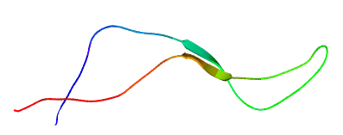
iteration
10
*Adapted from slides by Chen Kaeasar, Ben-Gurion University

Slide 29
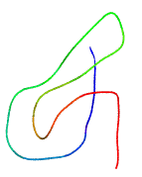
iteration
100
*Adapted from slides by Chen Kaeasar, Ben-Gurion University

Slide 30
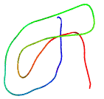
iteration
200
*Adapted from slides by Chen Kaeasar, Ben-Gurion University

Slide 31
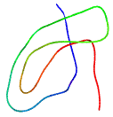
iteration
400
*Adapted from slides by Chen Kaeasar, Ben-Gurion University

Slide 32
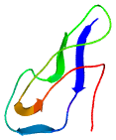
iteration
800
*Adapted from slides by Chen Kaeasar, Ben-Gurion University

Slide 33
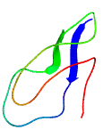
iteration
1000
*Adapted from slides by Chen Kaeasar, Ben-Gurion University

Slide 34
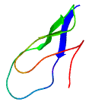
iteration
1200
*Adapted from slides by Chen Kaeasar, Ben-Gurion University

Slide 35
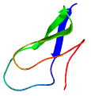
iteration
1400
*Adapted from slides by Chen Kaeasar, Ben-Gurion University

Slide 36
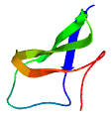
iteration
1600
*Adapted from slides by Chen Kaeasar, Ben-Gurion University

Slide 37

iteration
1800
*Adapted from slides by Chen Kaeasar, Ben-Gurion University

Slide 38

iteration
2000
*Adapted from slides by Chen Kaeasar, Ben-Gurion University

Slide 39
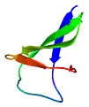
iteration
4000
*Adapted from slides by Chen Kaeasar, Ben-Gurion University

Slide 40

This time succeeded, in many cases not.
iteration
7000
*Adapted from slides by Chen Kaeasar, Ben-Gurion University

Slide 41
What kind of paths do we want?
The path to the global minimum
*Adapted from slides by Chen Kaeasar, Ben-Gurion University

Slide 42
What kind of paths do we want?
The path to the global minimum
*Adapted from slides by Chen Kaeasar, Ben-Gurion University

Slide 43
What kind of paths do we want?
The path to the global minimum
*Adapted from slides by Chen Kaeasar, Ben-Gurion University

Slide 44
What kind of paths do we want?
The path to the global minimum
*Adapted from slides by Chen Kaeasar, Ben-Gurion University

Slide 45
What kind of paths do we want?
The path to the global minimum
*Adapted from slides by Chen Kaeasar, Ben-Gurion University

Slide 46
What kind of paths do we want?
The path to the global minimum
*Adapted from slides by Chen Kaeasar, Ben-Gurion University

Slide 47
What kind of paths do we want?
The path to the global minimum
*Adapted from slides by Chen Kaeasar, Ben-Gurion University

Slide 48
What kind of paths do we want?
The path to the global minimum
*Adapted from slides by Chen Kaeasar, Ben-Gurion University

Slide 49
What kind of paths do we want?
The path to the global minimum
*Adapted from slides by Chen Kaeasar, Ben-Gurion University

Slide 50
What kind of paths do we want?
The path to the global minimum
*Adapted from slides by Chen Kaeasar, Ben-Gurion University

Slide 51
What kind of paths do we want?
The path to the global minimum
*Adapted from slides by Chen Kaeasar, Ben-Gurion University

Slide 52
What kind of paths do we want?
The path to the global minimum
*Adapted from slides by Chen Kaeasar, Ben-Gurion University

Slide 53
What kind of paths do we want?
The path to the global minimum
*Adapted from slides by Chen Kaeasar, Ben-Gurion University

Slide 54
What kind of paths do we want?
The path to the global minimum
*Adapted from slides by Chen Kaeasar, Ben-Gurion University

Slide 55
What kind of paths do we want?
The path to the global minimum
*Adapted from slides by Chen Kaeasar, Ben-Gurion University

Slide 56
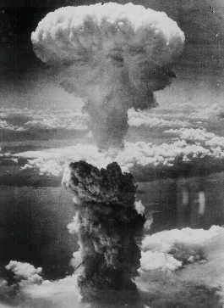

Monte-Carlo methods (a.k.a. MC simulations, MC sampling or MC search)
Monte-Carlo methods (“casino” methods) are a very general term for estimations that are based on a series of random samples
Samples can be dependent or independent
MC physical simulations are most famous for their role in the Manhattan Project (Uncle of Polish mathematician Stanisław Marcin Ulam’s was said to be a heavy gambler)

Slide 57
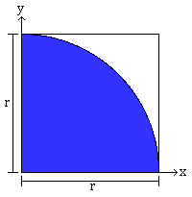
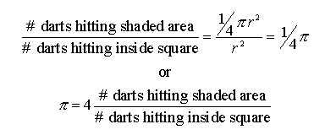
Example: estimating Π by independent Monte-Carlo samples (I)
Suppose we throw darts randomly (and uniformly) at the square:
Algorithm:
For i=[1..ntrials]
x = (random# in [0..r])
y = (random# in [0..r])
distance = sqrt (x^2 + y^2)
if distance ≤ r
hits++
End
Output:
Adapted from course slides by Craig Douglas

Slide 58

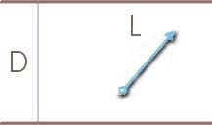
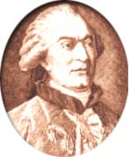
Buffon's original form was to drop a needle of length L at random on grid of parallel lines of spacing D.
Georges Louis Leclerc Comte de Buffon (7/9/1707-16/4/1788)
For L less than or equal D we obtain :
P(needle intersects the grid) = 2 • L / PI • D.
If we drop the needle N times and count R intersections we obtain :
P = R / N,
PI = 2 • L • N / R • D.
Slide from course CS521 by Craig Douglas

Slide 59
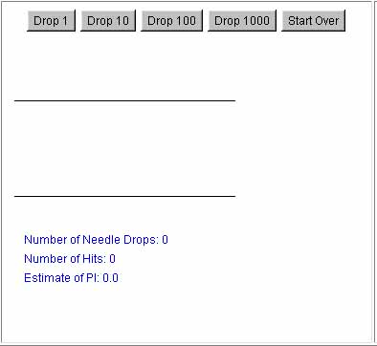
Slide from course CS521 by Craig Douglas

Slide 60
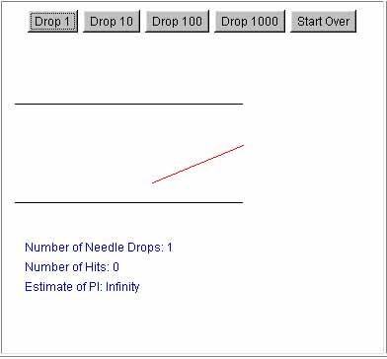
Slide from course CS521 by Craig Douglas

Slide 61
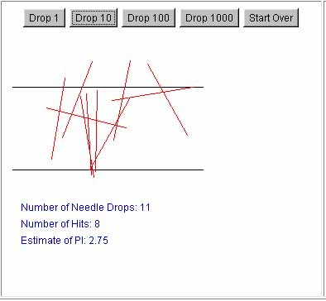
Slide from course CS521 by Craig Douglas

Slide 62
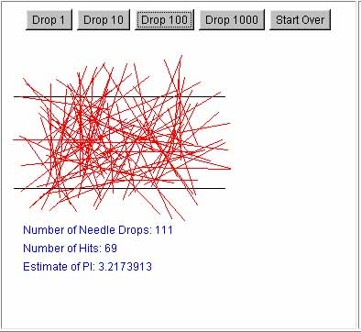
Slide from course CS521 by Craig Douglas

Slide 63
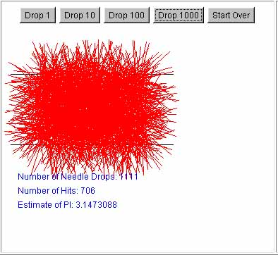
Slide from course CS521 by Craig Douglas

Slide 64
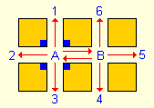
Drunk Sailor’s Random Walk
http://www.chem.uoa.gr/applets/AppletSailor/Appl_Sailor2.html
0.5
0.25
0.25
0.25
0.25
0.25
0.25
0.25
What is the probability that the sailor will leave through each exit?

Slide 65
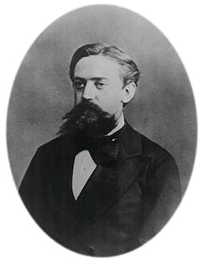
Markov-Chain Monte Carlo (MCMC)
Markov-Chain: future state depends only on present state
Markov-Chain Monte-Carlo on Graphs: we randomly walk from node to node with a certain probability, that depends only on our current location.
0.5
0.75
0.5
0.25

Slide 66
Analysis of a Two-Nodes Walk
0.5
A
B
After n rounds, what is the probability of being in node A?
0.75
0.5
0.25
Assume Pr_{n+1}A ≈ Pr_{n}A for a large n:
→Pr_{n+1}A = Pr_{n}A x 0.75 + Pr_{n}B x 0.5
0.25 x Pr_{n}A = Pr_{n}B x 0.5
→Pr_{n}A = 2 x Pr_{n}B
So: Pr∞A = ⅔ Pr∞B = ⅓

Slide 67
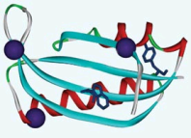
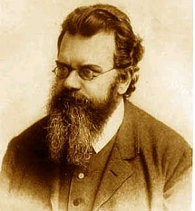
MCMC algorithm for sampling protein conformations
For n iterations:
Propose a random transition that perturbs the structure, drawn from some proposal distribution* Q(c_{next}|c_{current})
Accept new conformation with a certain probability p (or reject with probability 1-p)
After a long run, we want to find low-energy conformations, with high probability
A (physically) natural* choice is the Boltzman distribution, proportional to:
E_{i} = energy of state i
k_{B} = Boltzmann constant
T = temperature
Z = “Partition Function” constant
Protein image taken from Chemical Biology, 2006
* The proposal distribution can be any arbitrary “nice” distribution, for which the probability to transition between any two states is strictly positive, after a finite number of iterations
But how?

Slide 68

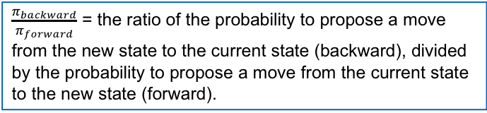
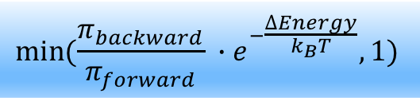
The Metropolis-Hastings Criterion
"Equations of State Calculations by Fast Computing Machines“ – Metropolis, N. et al. Journal of Chemical Physics (1953)
Boltzmann Distribution:
Assume the energy score and temperature are computable
The challenging part is calculating Z (״partition function״) – requires summing over all states.
Metropolis showed that MCMC will converge to the true Boltzmann distribution, if we accept a new proposal with probability
$$min⁡({\frac{π_{backward}}{π_{forward}} ∙e}^{−\frac{∆Energy}{k_{B}T}},1)$$
$\frac{π_{backward}}{π_{forward}}$ = the ratio of the probability to propose a move from the new state to the current state (backward), divided by the probability to propose a move from the current state to the new state (forward).

Slide 69
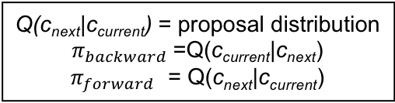
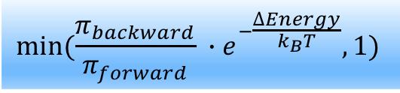
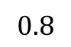
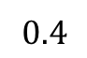
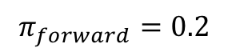
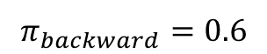
Making sense of the Metropolis criterion
P(c) - target distribution (e.g. Boltzmann):
Metropolis accept probability:
$$min⁡({\frac{π_{backward}}{π_{forward}} ∙e}^{−\frac{∆Energy}{k_{B}T}},1)$$
Q(c_{next}|c_{current}) = proposal distribution
$π_{backward}$ =Q(c_{current}|c_{next})
$π_{forward}$ = Q(c_{next}|c_{current})
$$0.8$$
$$0.4$$
Q(A)=0.75
E=10 k_{B}T
P(A)=0.5
Q(B)=0.25
E=10 k_{B}T
P(B)=0.5
$$π_{backward}=0.6$$
$$π_{forward}=0.2$$

Slide 70
MCMC Algorithm for sampling protein conformations based on Metropolis-Hastings
For n iterations:
Propose a random transition that perturbs the structure, drawn from some arbitrary proposal distribution* Q(c_{next}|c_{current})
Calculate an acceptance probability p using the Metropolis criterion
Accept new conformation with probability p (or reject with probability 1-p)
If we run till infinity, with good perturbations, we will visit every conformation according to the Boltzmann distribution
But we just want to find the energy minimum. If we do our perturbations in a smart manner, we can still cover relevant (realistic, low-energy) parts of the search space
Protein image taken from Chemical Biology, 2006
* The proposal distribution can be any arbitrary “nice” distribution, for which the probability to transition between any two states is strictly positive, after a finite number of iterations

Slide 71

Trick 1: Simulated Annealing
The Boltzmann distribution depends on the in-silico temperature T:
At low temperatures, we will get stuck in local minima (we will always get zero if the energy rises even slightly)
At high temperatures, we will always get 1 (jump between conformations like nuts).
$$min⁡({\frac{π_{backward}}{π_{forward}} ∙e}^{−\frac{∆Energy}{k_{B}T}},1)$$
In simulated annealing, we gradually decrease (“cool down”) the virtual temperature factor, until we converge to a minimum

Slide 72
Trick 2: Monte-Carlo with Energy Minimization (MCM) Scheraga et al., 1987
Gradient-based methods are suitable for identifying near-by local minima (gradient descent, etc.)
Monte-Carlo can be used for bigger transitions among local minima

Slide 73
Trick 3: Switching between low-resolution (smooth) and high-resolution (ragged) configuration spaces (energy functions)
Low-res configuration space
Smooth energy function
A lower-dimensional configuration space (e.g. centroids of several atoms) with a smoother (e.g. averaged) energy landscape is used to rapidly sample large perturbations
A higher-dimensional configuration space with a rougher (though more accurate) energy function is used for fine tuning
START
High-res configuration space
Rough (bumpy) energy function
energy
configurations

Slide 74
Trick 4: Repulsive Energy Ramping
Example: Repulsion among neighboring atoms is a main driver of local minima
Start simulations with lowered repulsive energy term, and gradually ramp it up during the simulation
Similar rational to Simulated Annealing
Trick 5: Modulating Perturbation Step Size
Too small pertubation size can lead to a very slow simulation → we remain stuck in the local minimum
A large perturbation size can lead to clashes and a very high rejection rate → we remain stuck in the same local minimum
We can increase or decrease the step size until a fixed rejection rate (for example, 50%) is achieved

Slide 75
Other popular variants
Hamiltonian MCMC (HMC) (Duane, Kennedy, Pendelton and Roweth 1987)
Proposal distribution is based on short molecular dynamic simulations (later in course)
Applications to Neural networks (Neal, 1996)
No U-Turn MCMC (NUTS) (Hoffman and Gelman, 2011)
Based on Hamiltonian MCMC
A recursive scheme for automatically tuning HMC parameters and preventing resampling
Notes:
Duane et al. 1987 - https://www.sciencedirect.com/science/article/abs/pii/037026938791197X
Neal 1996a - http://citeseerx.ist.psu.edu/viewdoc/download?doi=10.1.1.446.9306&rep=rep1&type=pdf
Reviewed – Handbook of Markov Chain Monta Carlo 2011,MCMC Using Hamiltonian Dynamics (Neal, 2011)
NUTS MCMC - http://www.stat.columbia.edu/~gelman/research/unpublished/nuts.pdf

Slide 76
Monte-Carlo in Rosetta
In Rosetta, it is common to use any of the above tricks, MCM in particular
In general, a single simulation is short (no more than a few minutes), but is repeated k independent times – getting k sampled “decoys”
We use energy scoring to decide which is the best decoy structure – hopefully this is the near-native solution
Low-resolution sampling is often used to create a very large number of initial decoys, and only the best one are moved to high-resolution minimization

Slide 77
Summary: optimization methods
Gradient-based methods are suitable for identifying near-by energy minima
Metroplois-Hastings MCMC can recover the Boltzmann distribution in some applications, but for protein folding, we cannot hope to cover the huge conformational space, or recover the Boltzman distribution.
“The art”: some tricks help us find good low-energy near-native.
We didn’t cover some very popular non-linear optimization methods:
Linear and convex programming ; expectation maximization algorithm ; Branch and bound algorithms ; Dead-end elimination; mean-field approach ; And more…

